Slide 1
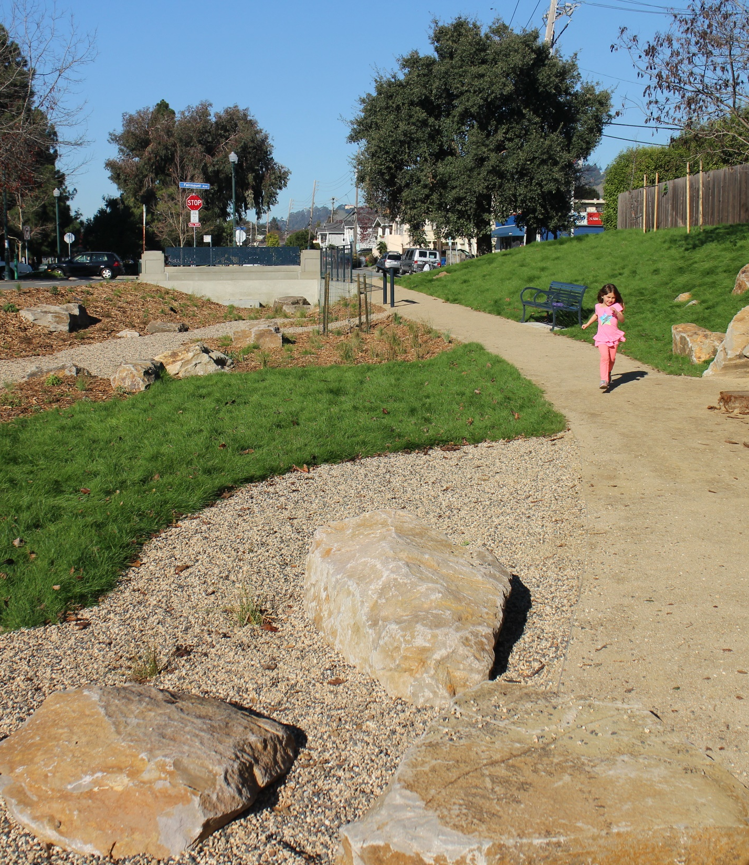
17 LID
Lessons
Learned
Dan Cloak, P.E.

Slide 2

1. Elegance
Regulatory Drivers
Mandate
Client support
Acceptance
of costs
Structure
Schedule
Accountability
Project Quality
Enthusiasm
Interest
Energy
Synergies
Opportunities
Elegance

Slide 3
2. Barriers, What Barriers?

Slide 4
3. Low Cost Option
Capital Costs
Operation and Maintenance Costs

Slide 5
4. Four Percent
½ Acre
4%
30 ft

Slide 6
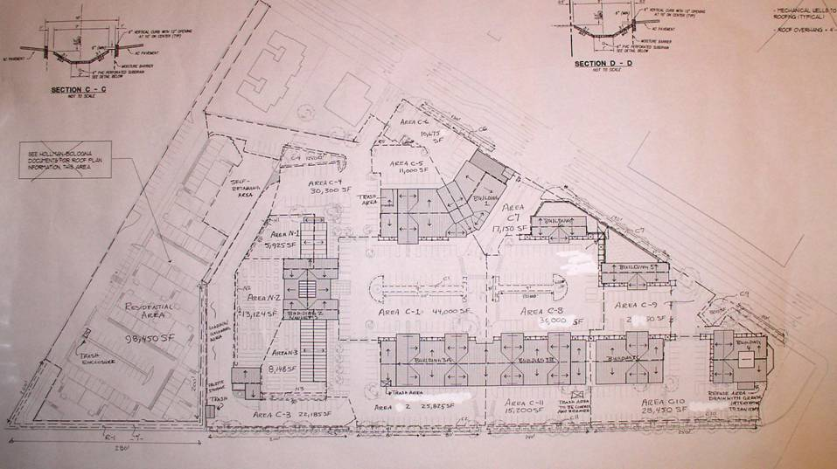
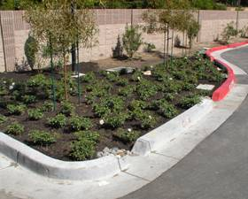
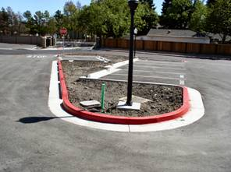
5. Nearly Everywhere
DMAs

Slide 7
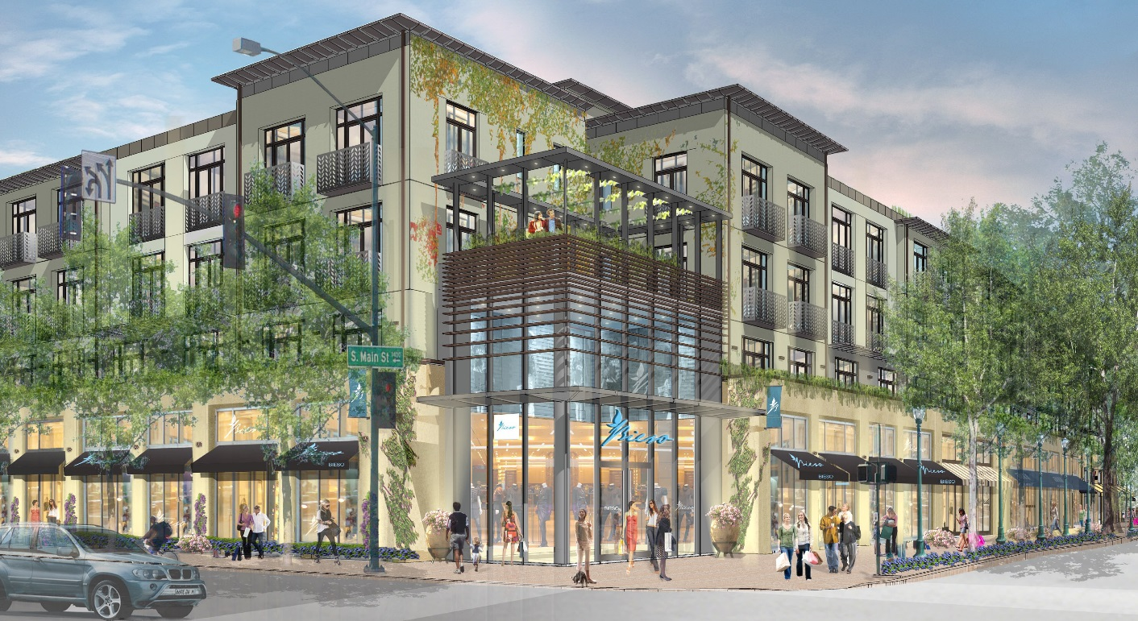
6. Lot Size, Not Land Use

Slide 8
7. Deemed Complete
Pre-Application
Meeting
Completed
Application
“Deemed
Complete”
Section
Review
Planning
Commission
Conditions of
Approval
CEQA
Review
Detailed
Design
Plan Set and
Permit
Application
Construction

Slide 9
8. Subdivisions

Slide 10
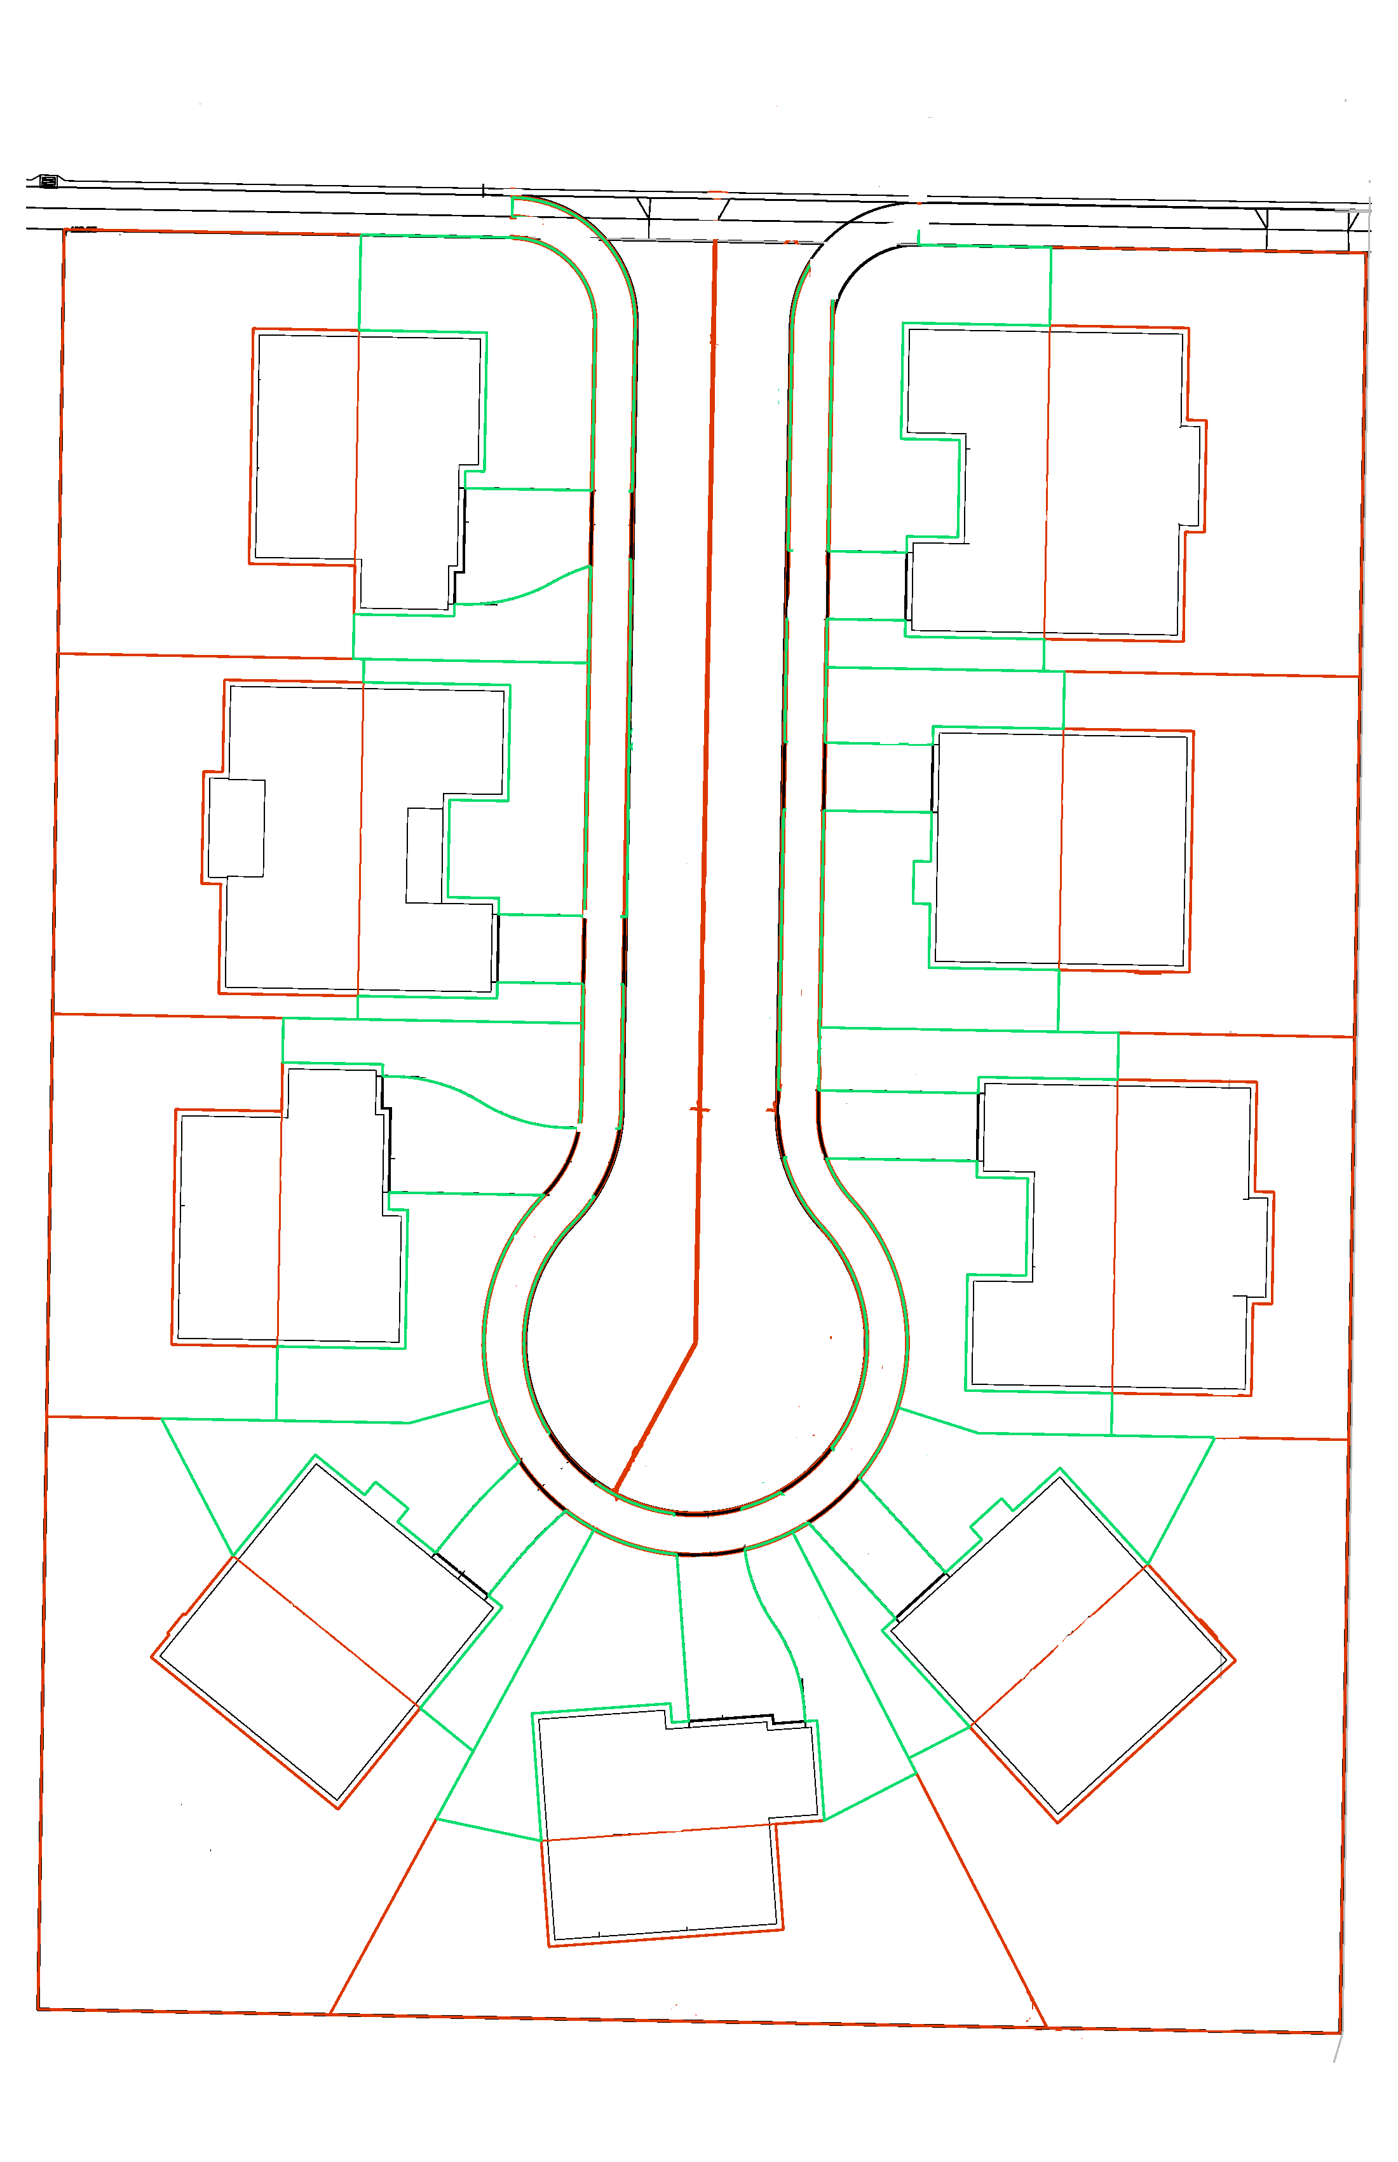

8. Subdivisions
Stormwater Control Plan Exhibit
Whispering Pines Lane
Bioretention 1 2600 SF
Bioretention 2 2700 SF
LP
1-RR
1388
1-RF
1846
1-FY-2
1625
+102.4
9-RF
2204
9-RR
2550
9-FY-2
1670
Drain a portion of each roof to yard
Drain driveways to street
Drain street to bioretention facilities on commonly owned parcels
1-RY
4910
1-DW
805
9-RY
4150
1-FY-1
780
9-DW
370
9-FY-1 460
2-RY
3580
2-RR
2550
2-RF
2204
8-FY-1 870
8-DW
480
8-RF
1792
8-RR
1753
8-RY
4190
2-FY-1
1620
2-DW
400
8-FY-2
1715
2-FY-2 370
3-FY-1
1145
7-FY-2 920
3-DW
1000
7-DW
670
7-RY
2760
3-RY
3775
3-RR
1388
3-RF
1846
3-FY-2
1665
7-FY-1
1615
S-1
9330
S-2
10370
7-RF
2204
7-RR
2550
4-FY-2
1575
6-FY-1
1615
4-DW
520
HP
6-DW
555
4-RF
1792
6-RF
1792
4-RR
1753
5-FY-1
1045
5-DW
955
6-FY-2
615
4-FY-1
730
6-RR
1753
5-RF
1846
5-FY-2
1790
4-RY
8045
5-RR
1388
5-RY
5390
6-RY
8235
+103.6
+103.2
50 feet
EXAMPLE RESIDENTIAL SUBDIVISION EXHIBIT SEPTEMBER 24, 2015

Slide 11

9. Bioretention
evapotranspiration
losses
infiltration
Discharge
(biotreatment)

Slide 12
10. Flat, Flat, Flat

Slide 13
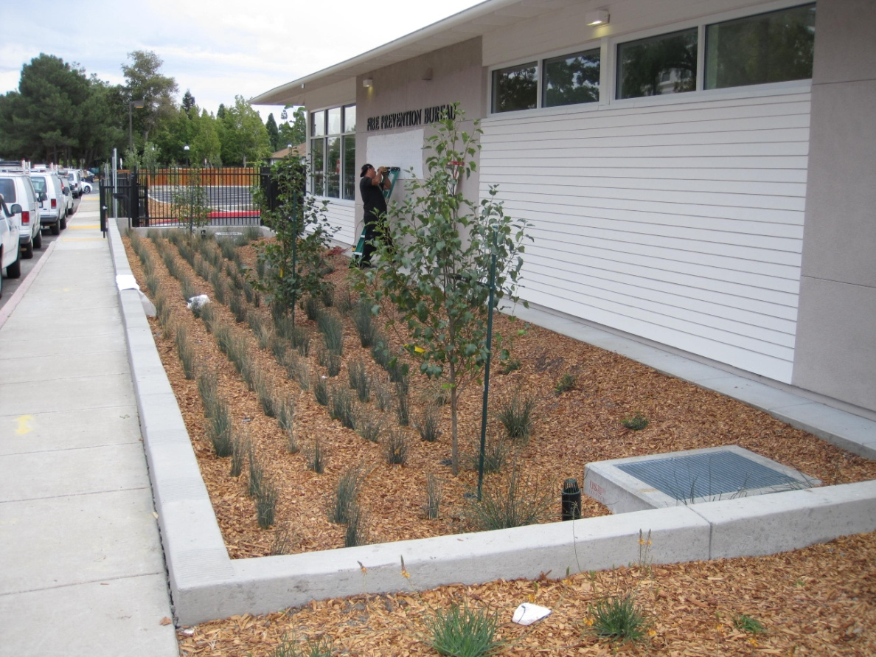
10. Flat, Flat, Flat

Slide 14
10. Flat, Flat, Flat
Not this
Or this

Slide 15
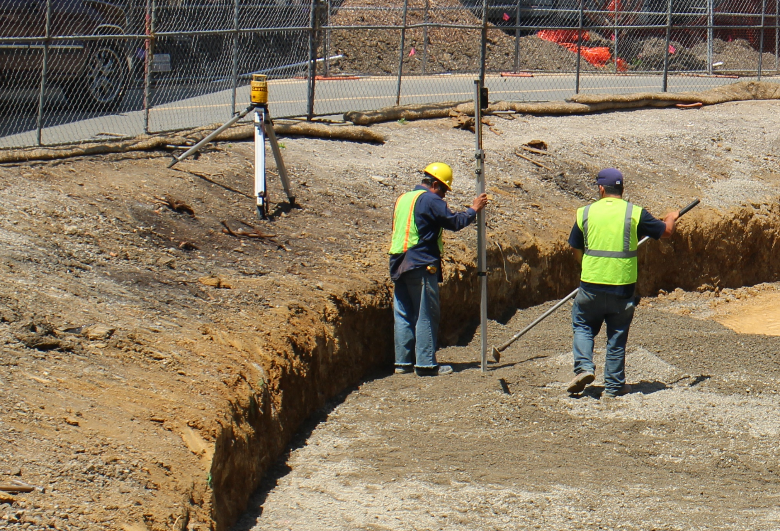
10. Flat, Flat, Flat

Slide 16
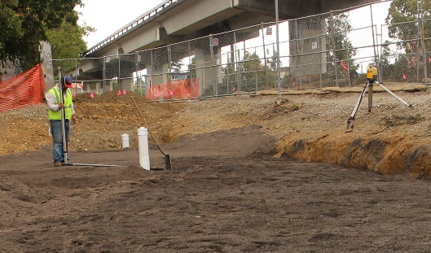
10. Flat, Flat, Flat

Slide 17
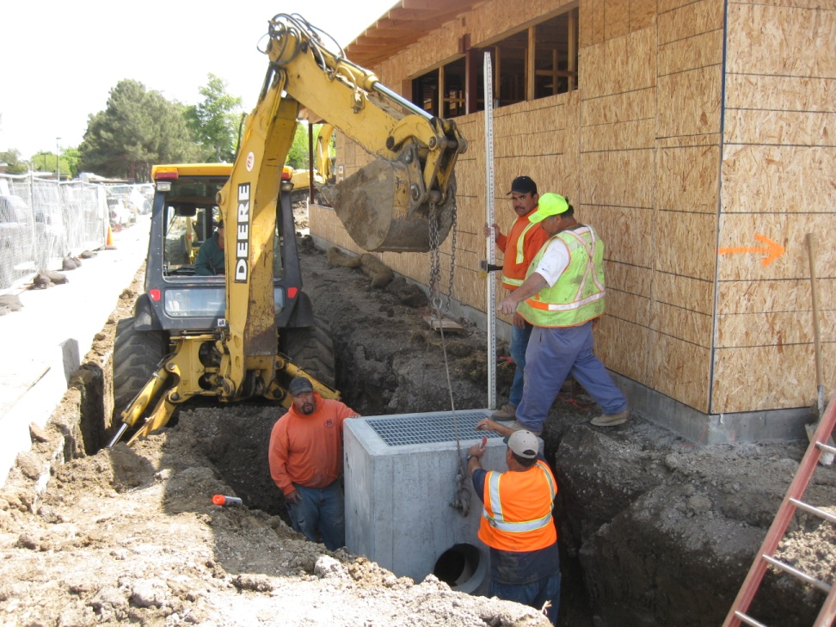
11. Overflow
Overflow
elevation

Slide 18
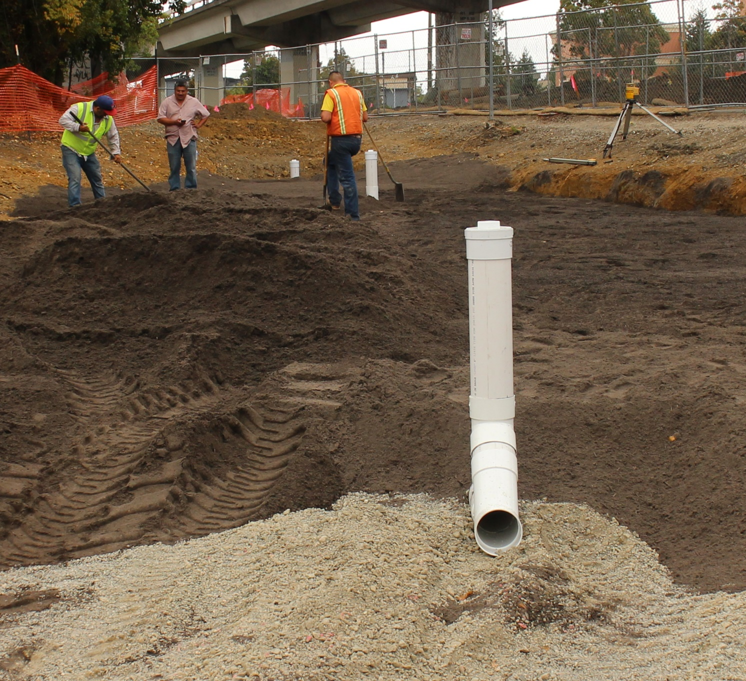
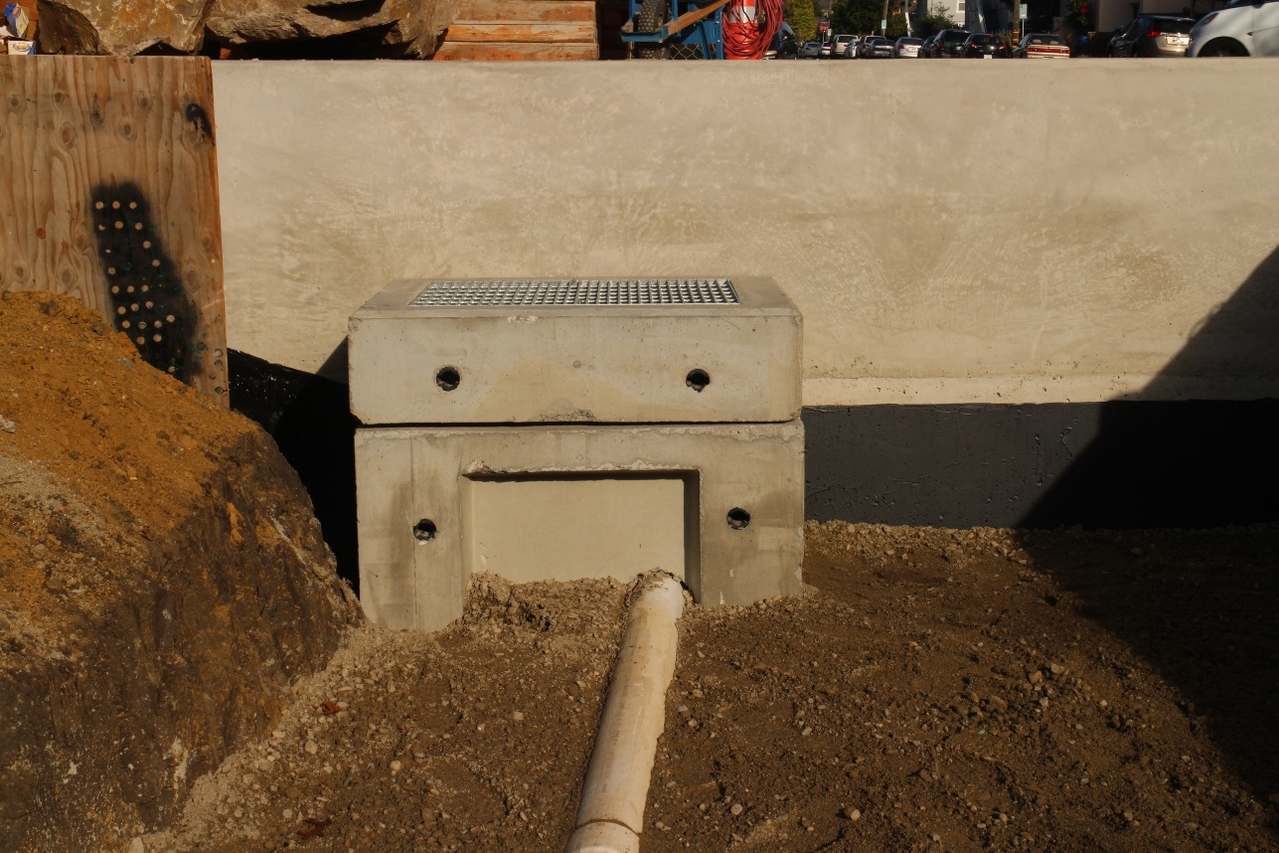
12. Raised Underdrain

Slide 19
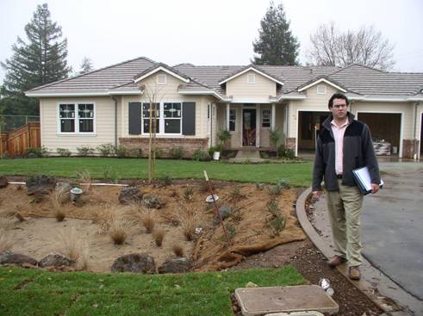
13. Keep It On the Surface

Slide 20
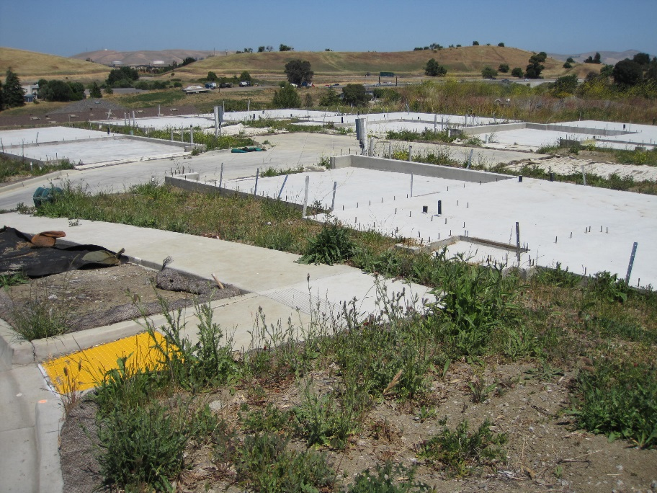
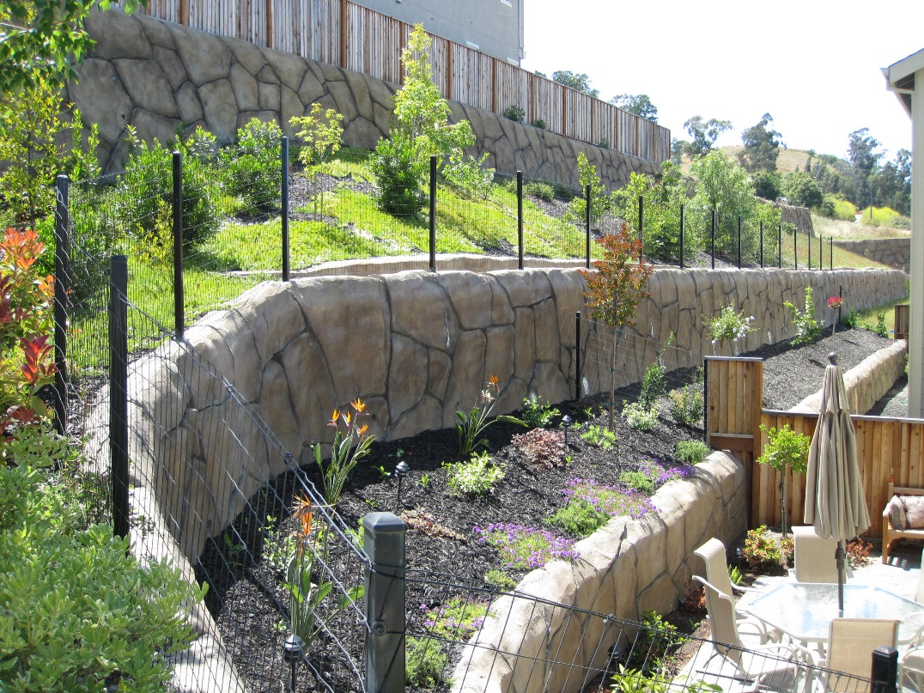
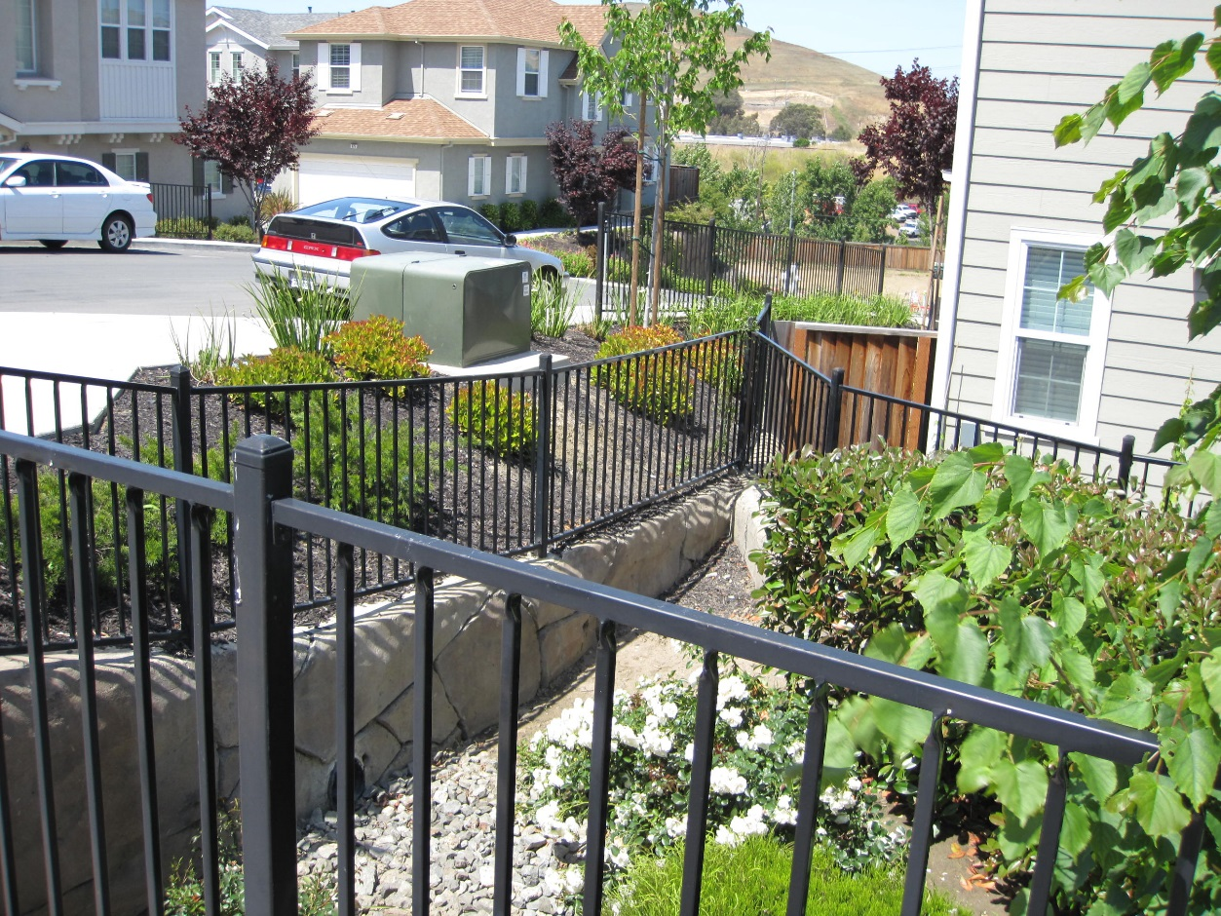
14. Geotechnically…

Slide 21
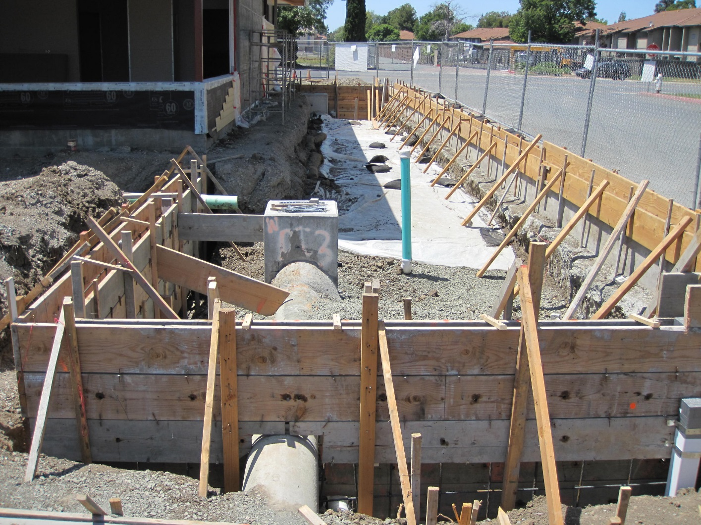
14. Geotechnically…

Slide 22
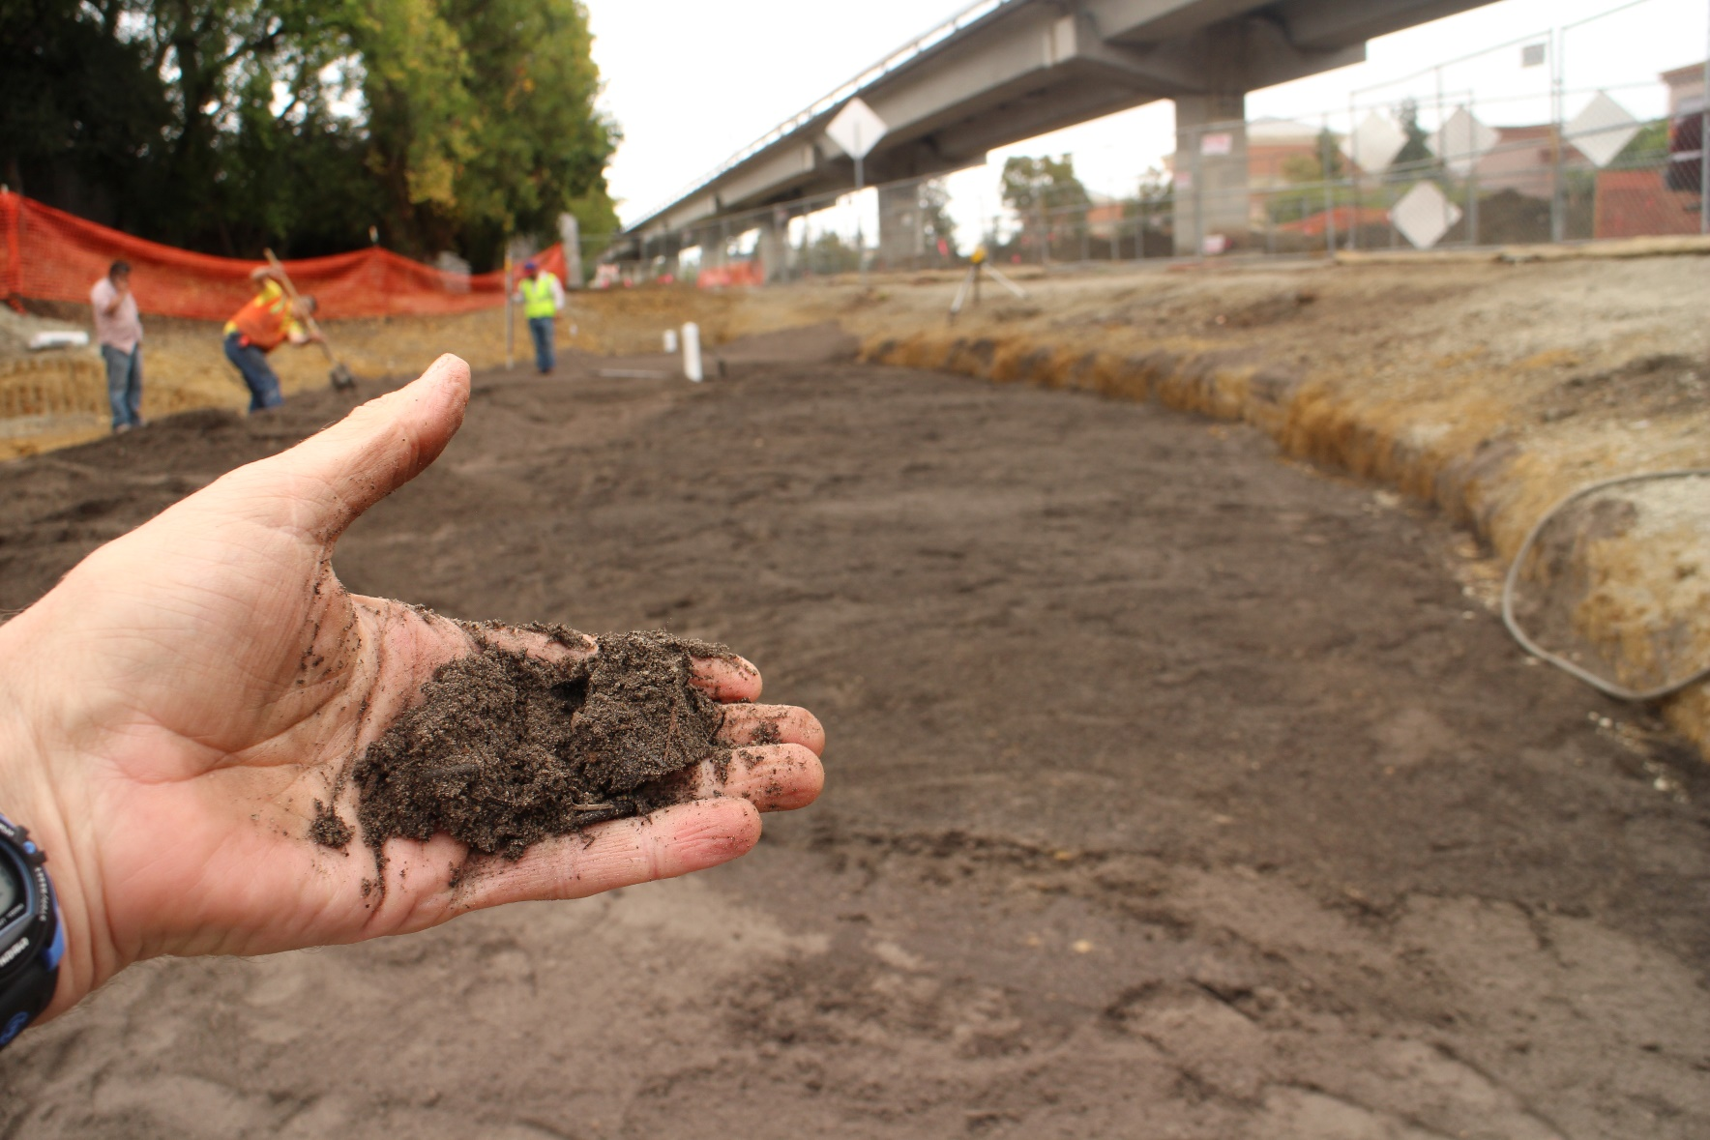
15. Sand and Compost

Slide 23
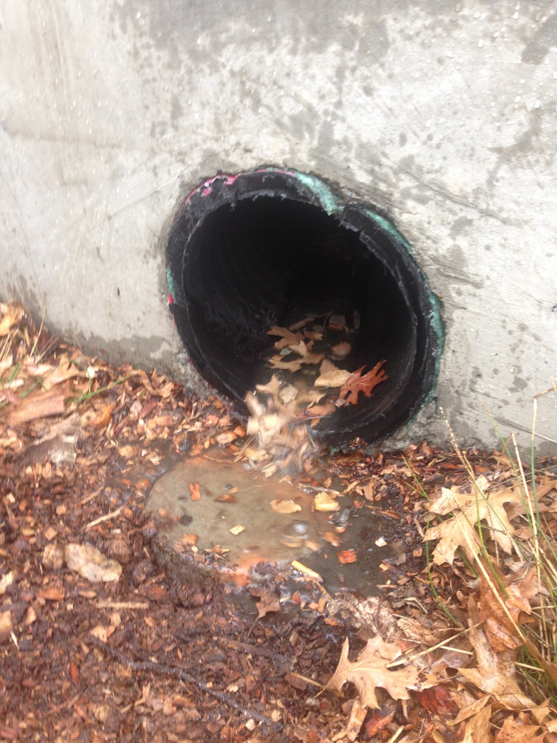
16. Pollutant Build-Up

Slide 24
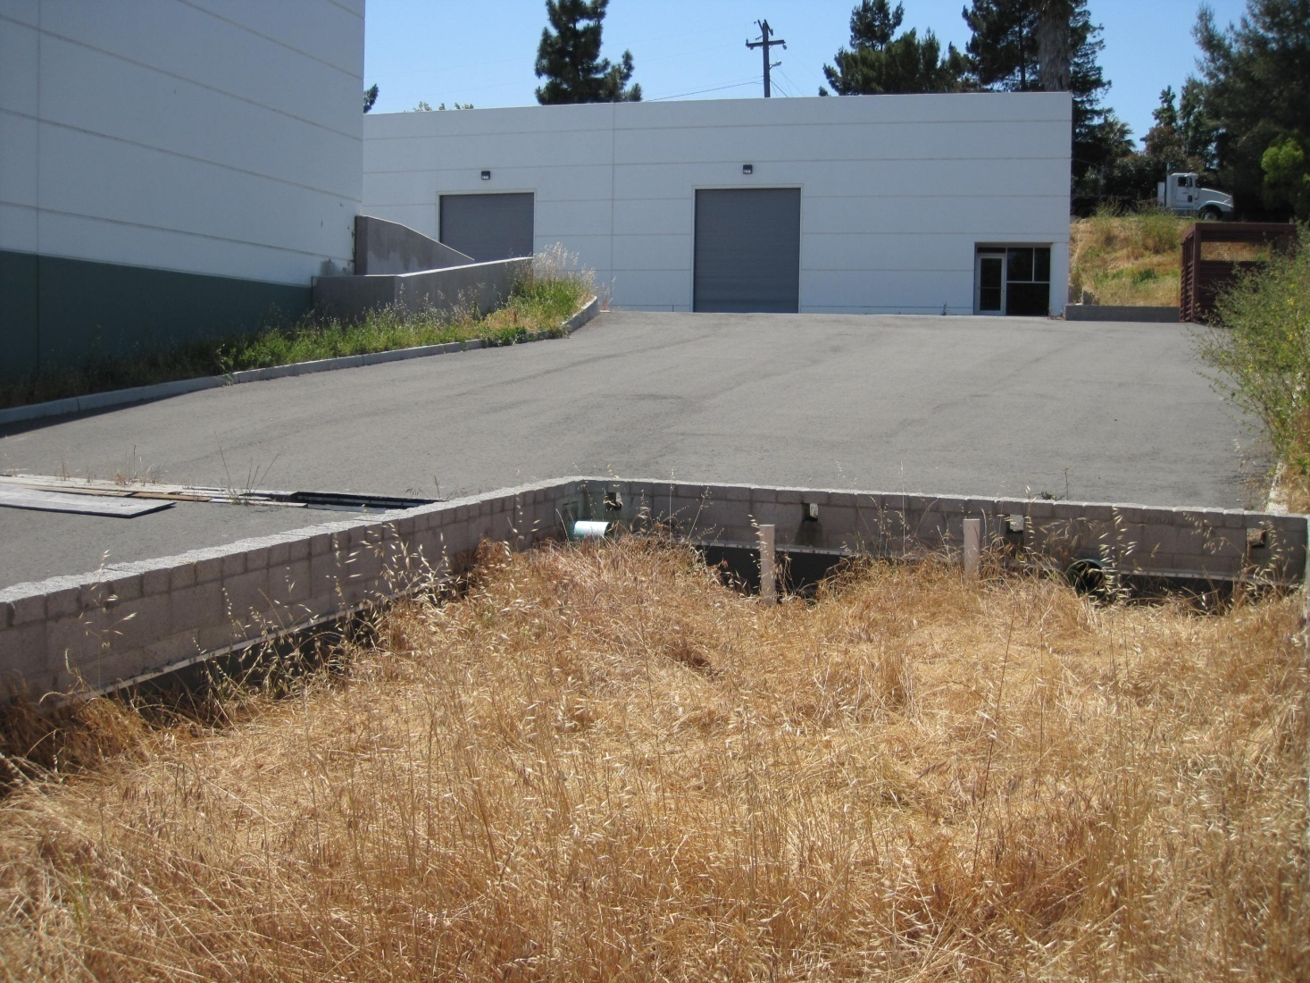
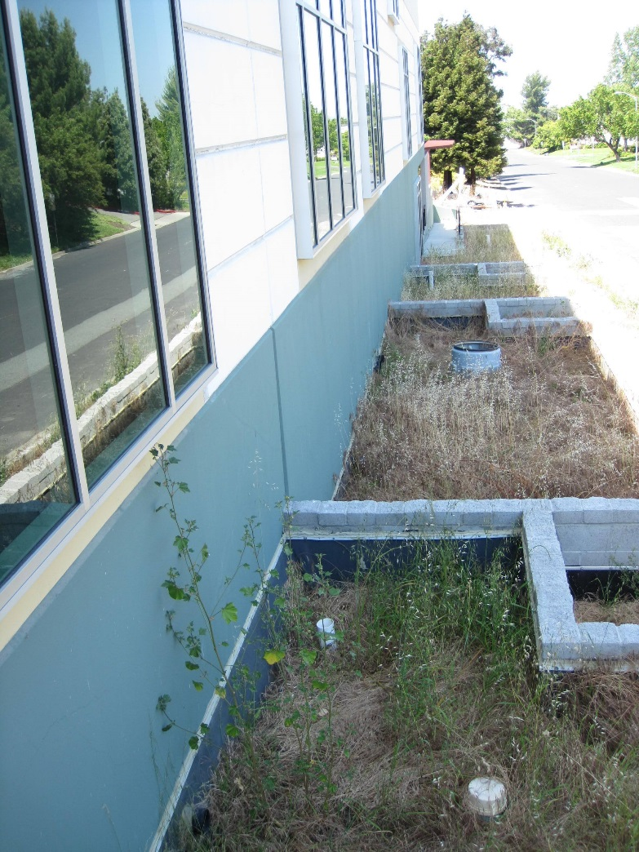
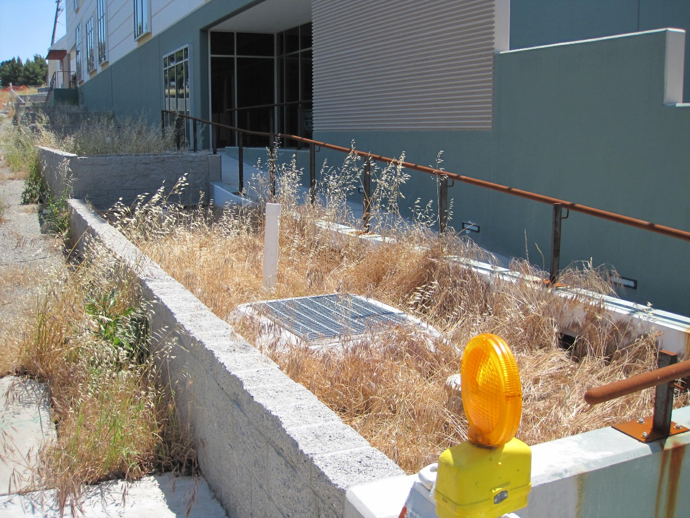
17. Resilience

Slide 25
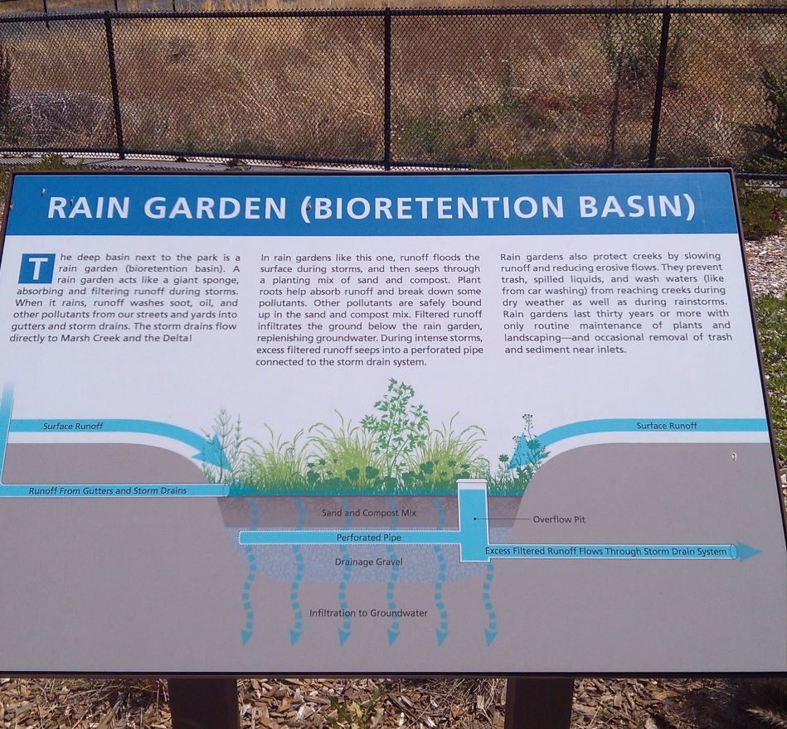
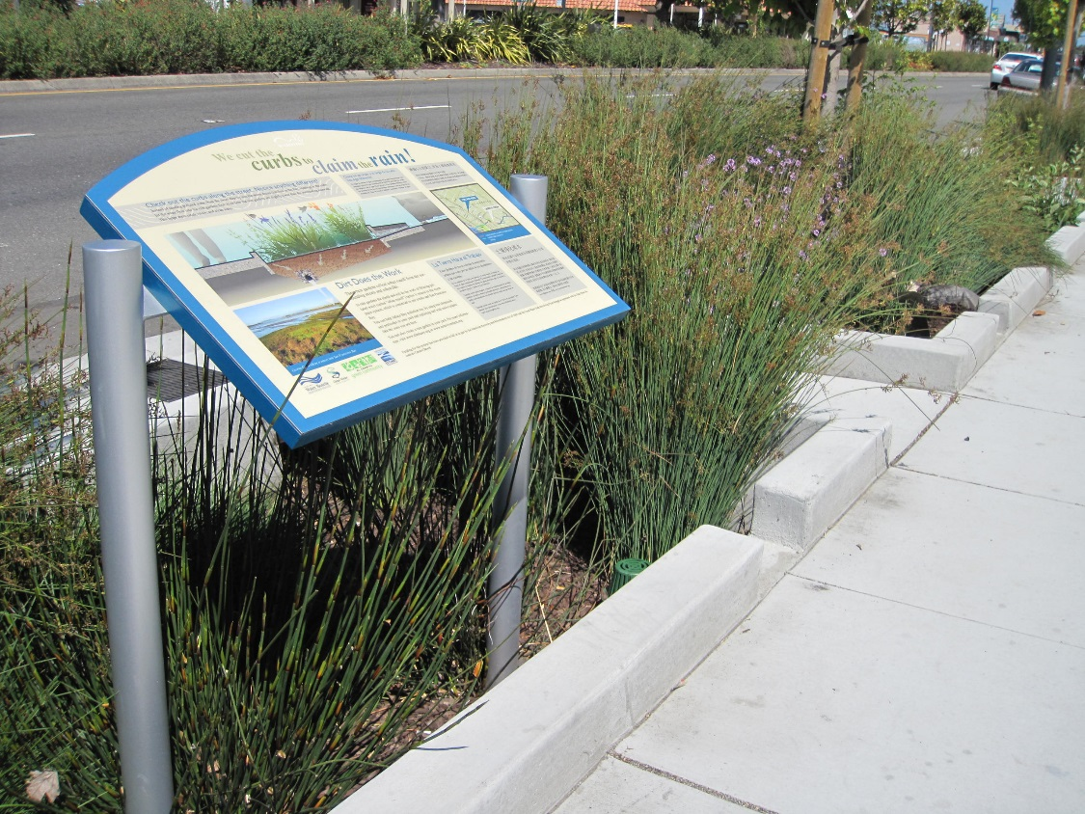
17. Resilience

Slide 26
17 LID
Lessons
Learned
Dan Cloak, P.E.

